Slide 1
Satellite Data for Climate Applications: Lessons from NOAA’s Climate Data Record Program
Jeffrey L. Privette, Chief, Climate Services and Monitoring Division
NOAA’s National Climatic Data Center
20 November 2014
NOAA Satellite and Information Service | NOAA’s National Climatic Data Center

Slide 2
Outline
A Climate Data Record Program for NPP/NPOESS
The diverse and growing climate application community, its changing needs and expectations
Meeting climate community product & service needs
Information vs. Data
Ease of access
Latency
Longevity

Slide 3
Outline
A Climate Data Record Program for NPP/NPOESS
The diverse and growing climate application community, its changing needs and expectations
Meeting climate community product & service needs
Information vs. Data
Ease of access
Latency
Longevity

Slide 4
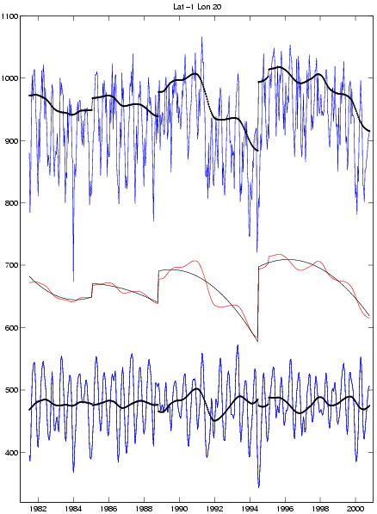
CDRs Provide Homogeneous Records Over Long Term
Uncorrected Records Contain Both Real and Artificial Signals
Operational weather and hazard products are produced rapidly to potentially save life and property
Top of Atmosphere Vegetation Index
New satellite launched
Vegetation Greenness Index
Top of Canopy Vegetation Index
Climate Data Records (CDRs) provide long term product consistency through rigorous reprocessing with advanced algorithms, ancillary data and evolved instrument understanding.
Time (year)
Image courtesy C. Tucker

Slide 5
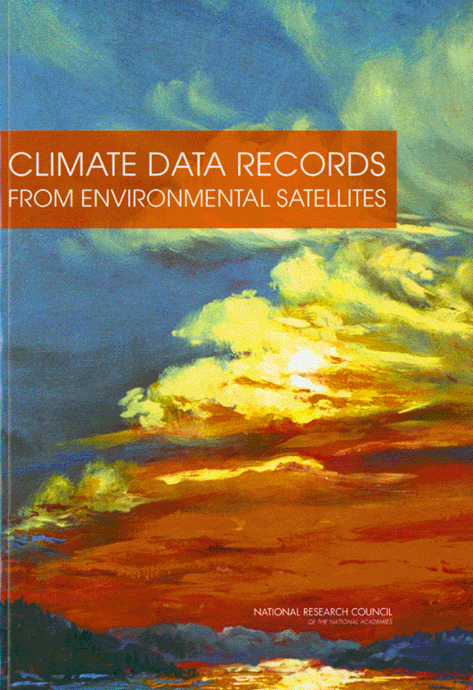
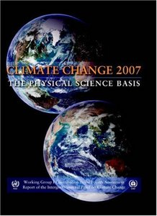
CDR Program Emerged Amid Heightened Global Change Concerns and NPOESS Gaps
NAP, 2004
IPCC AR4, 2007
NRC Decadal Survey, 2007

Slide 6
NOAA’s CDR Priorities Driven By Global Change Research Needs
etc. (28 CDR bundles in total)
Primary sensor is a costing convenience to associate each CDR with one and only one NPOESS era sensor. It is recognized that data from multiple satellite sensors, and in situ data, are often used to determine a CDR.
Significance to Global Change follows from a review of IPCC Fourth Assessment Report (2007).
In development: Based on NASA ROSES ’06 A.15 and NOAA SDS 2007 selections.
State and Forcing variable bundles, as defined by CCSP Strategic Plan Chapter 12, are prioritized at a 1:1 ratio.

Slide 7
NOAA’s CDR Requirements
The Climate Data Record model shown provides a pathfinder for most NCDC products
A Climate Data Record is a time series of measurements of sufficient length, consistency, and continuity to determine climate variability and change (NRC, 2000).
To achieve this, a Climate Data Record shall be:
Accessible
Continuously Assessed/ Improved
Extensible
Preserved
Reproducible
Scientifically defensible
Sustainable
Transparent
Available;
Easily obtained, affordable, and understand-able.
Evaluated on a scheduled basis, with the possibility of better methodologies being incorporated
Producing consistent results within machine rounding errors
Having the potential for long-term maintenance; capable of being continued without exhausting available resources
Based on testable hypotheses and methodologies that have been objectively and openly peer-reviewed
Forward compatible in accommodating new data from existing or new instruments;
Able to be adapted for use by others
Secured in perpetuity
Openly accountable in every respect

Slide 8
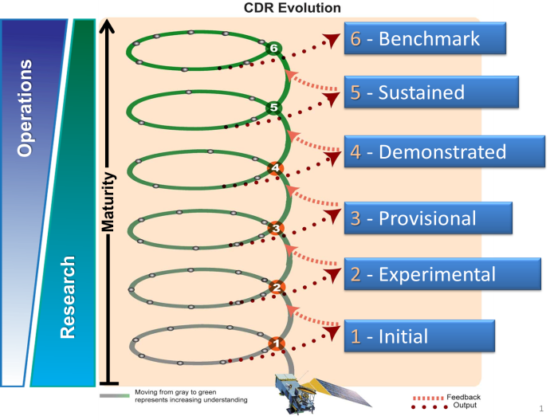
Spiral Development Model Envisioned R2O Transition of Algorithms

Slide 9
A Standards-based and Systems Engineering Approach to Operational CDRs

Slide 10
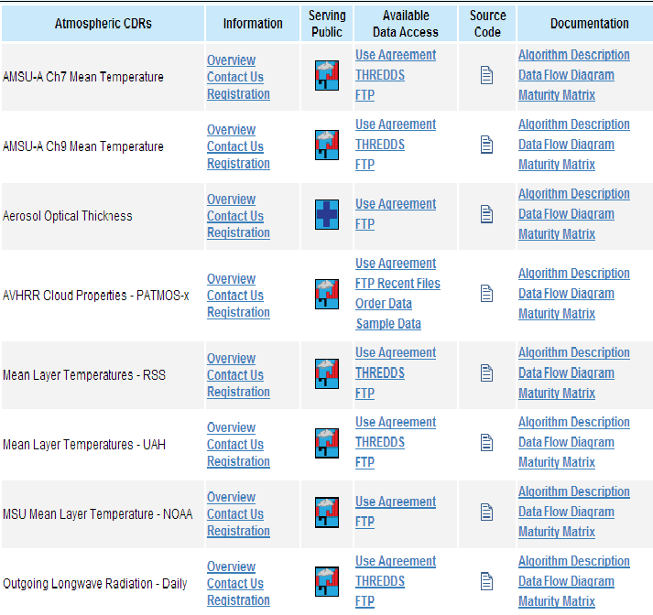
Results: 23 Mature Climate Data Records Are Now Operational, and More Coming
Additional groups include Land, Ocean and Fundamental (Sensor) CDRs

Slide 11
But, Midlife Questions Arose…
Are NOAA’s CDRs helping to improve the Nation’s (especially private sector’s) resilience to climate and weather?
What is a CDR’s economic value and impact?
Beyond academic researchers, who is using them, and for what?
How many CDRs is enough?
And the big one:
Does the Program assume “if we build it, they will come.”

Slide 12
Outline
A Climate Data Record Program for NPP/NPOESS
The diverse and growing climate application community, its changing needs and expectations
Meeting climate community product & service needs
Information vs. Data
Ease of access
Latency
Longevity

Slide 13
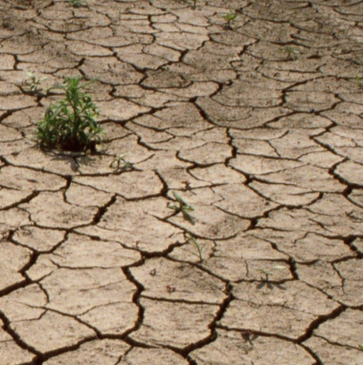
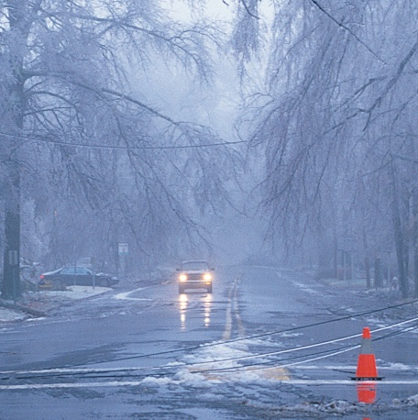
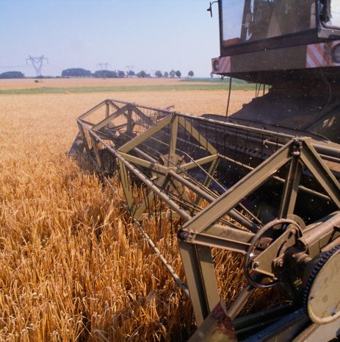
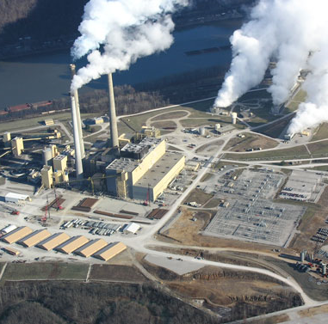
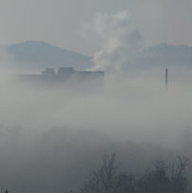
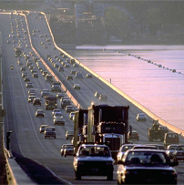
Society Has A Rising Demand for Climate Information
Sustainability of Marine Ecosystems
Coasts and Climate Resilience
Climate Impacts on Water Resources
Changes in Extremes of Weather and Climate
Agriculture
Energy
Health
Transportation

Slide 14
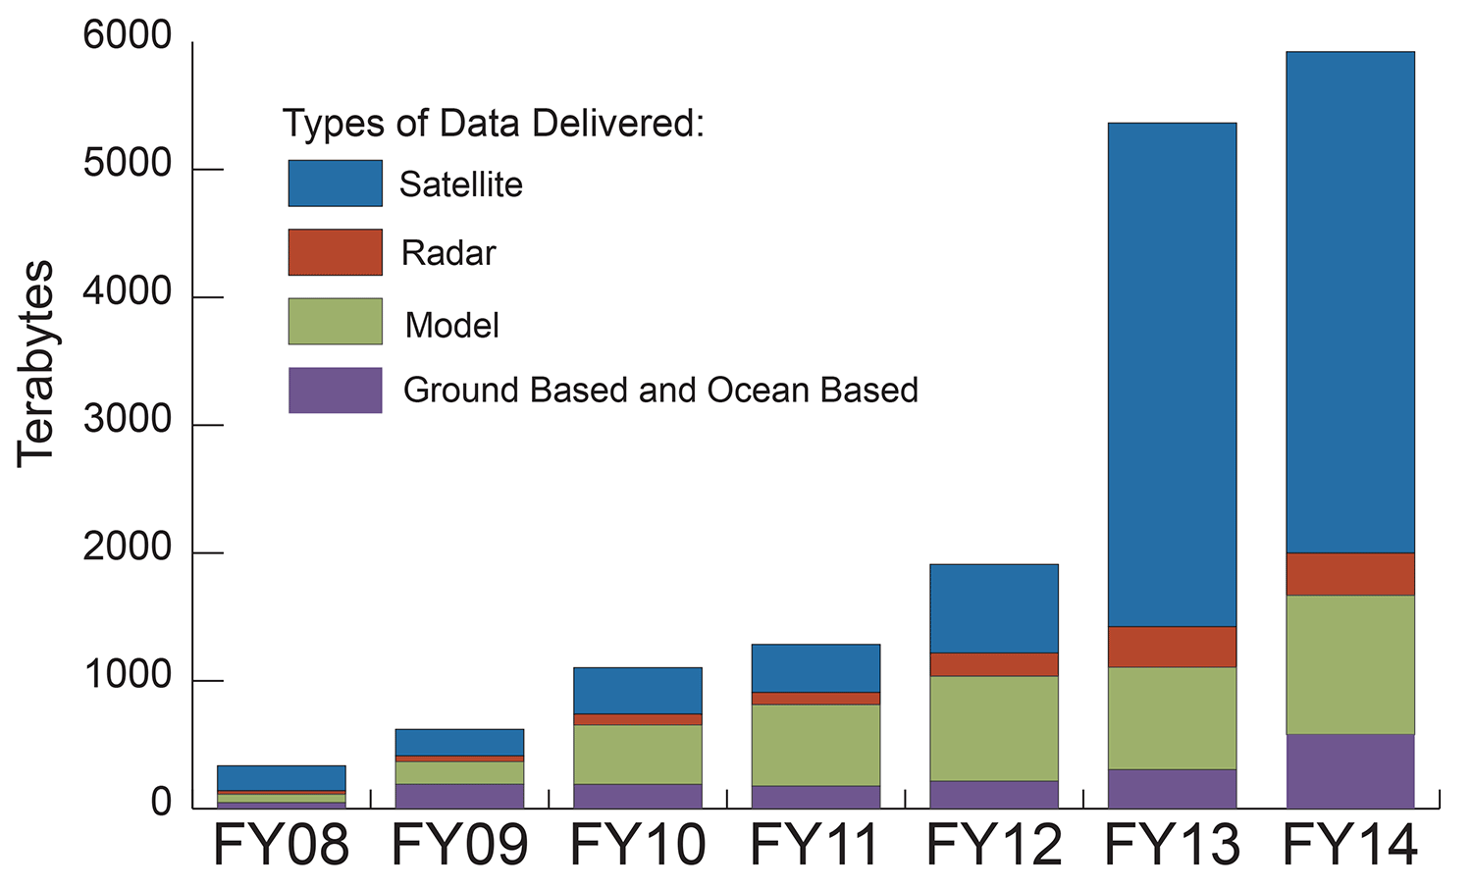
NCDC Statistics Confirm Many More Users
*
*
Notes:
Across the United States and around the world, people are making decisions to effectively minimize and prepare for the impacts of variations and changes in the climate system
These decisions require accurate, timely, and authoritative scientific weather and climate information
NCDC continues to strengthen and balance its portfolio of products and services to meet its stakeholders needs

Slide 15
Who Are They? NCDC’s Approximate User Profile
Fraction (%) | Data Expertise | Stereotypical User | Data or Info Need | Preferred Format | Access Volume | Access Frequency
70 | Low | Business, media, public | Qualitative | Point-and-click, graphics, assessments | Low | High
15 | High | Researchers, Climate consultancies | Quantitative | Digital downloads | High | Low
15 | High | Value-added Providers (DB scrapers) | Quantitative | Digital downloads | Low | High

Slide 16
Users Increasingly Only Want Salient Points
Aspects of Monitoring
Average values (13.3°C)
Measures of difference (+1.8°C above normal)
Measures of unusualness (much above average = top 10%)
Measures of trend (increasing at 0.5°C per century)
Measures of impact (34% of corn reported in poor condition)
Temperature
Drought
Precipitation
Wind
Violent Weather

Slide 17
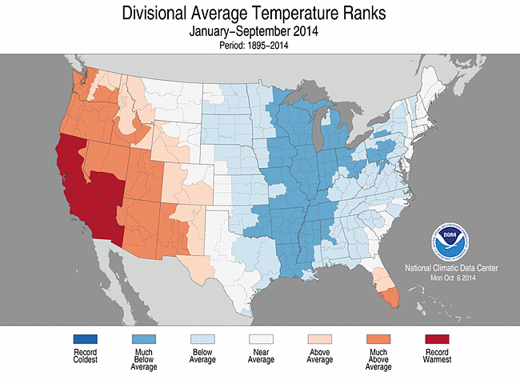
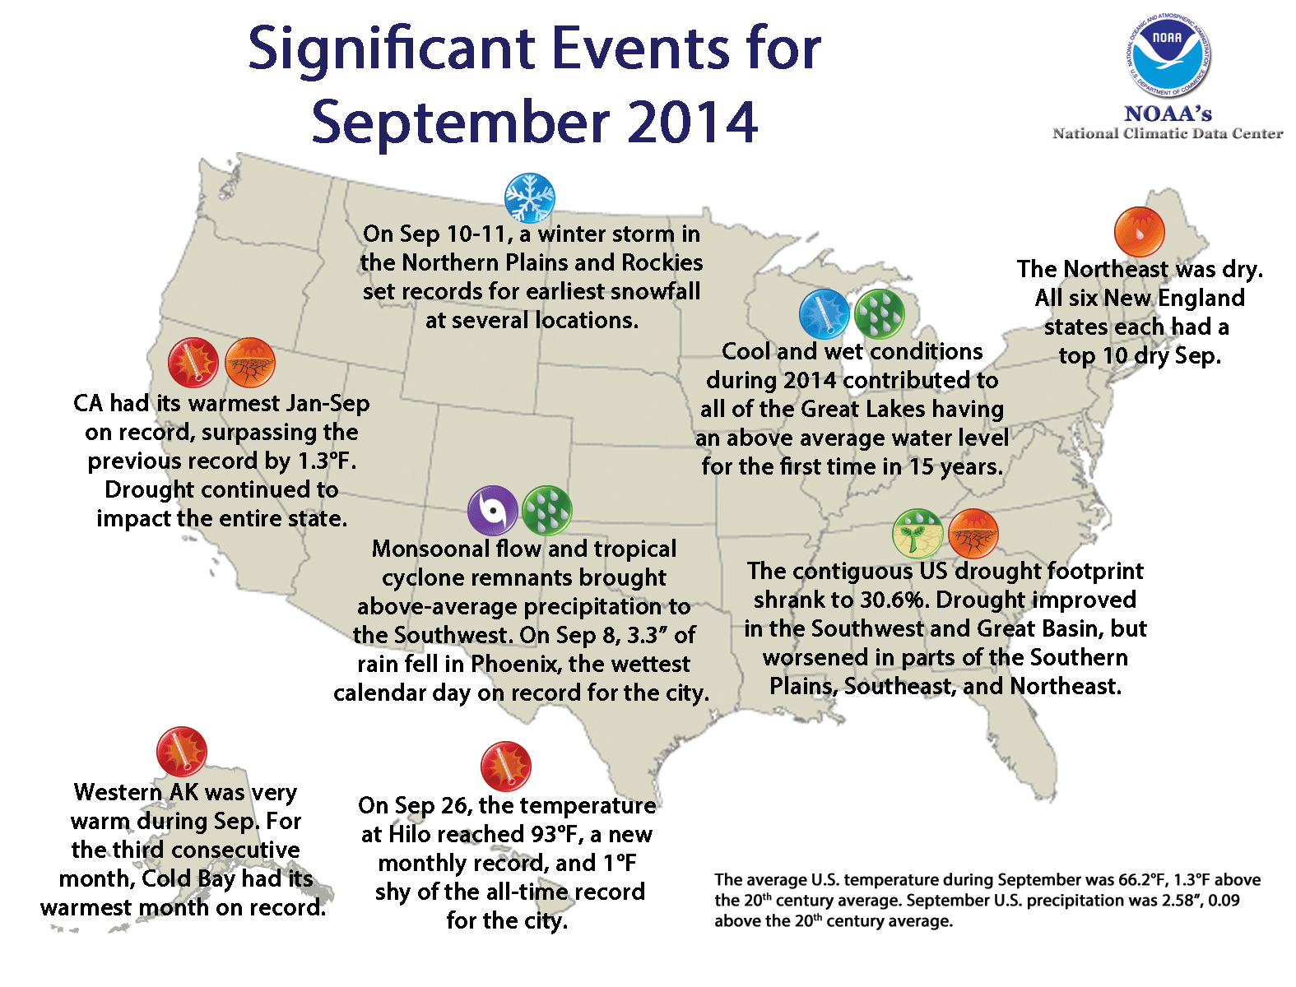
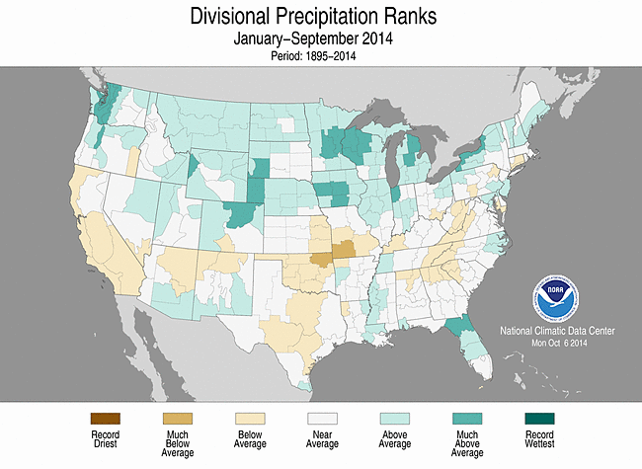
Monthly Reports Accessible to Non-Experts
Monthly update of pertinent data, analysis, and assessment of the climate situation for the USA
Reports: National Overview, Synoptic Discussion, Drought, Tornadoes, Tropical Cyclones (basins of US interest), US Snow & Ice.
Data Period of Record: 120 years (since 1895) unless otherwise noted

Slide 18
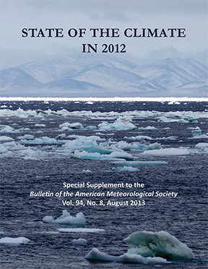
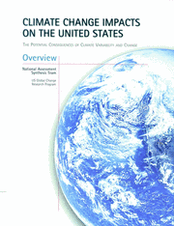
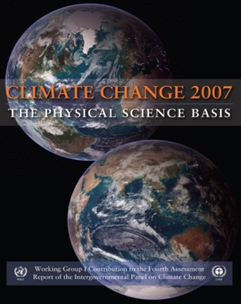
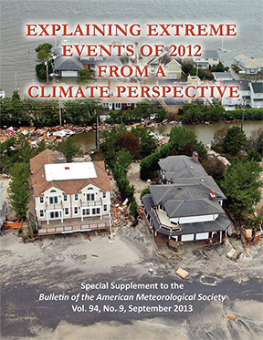
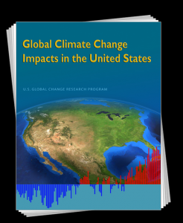
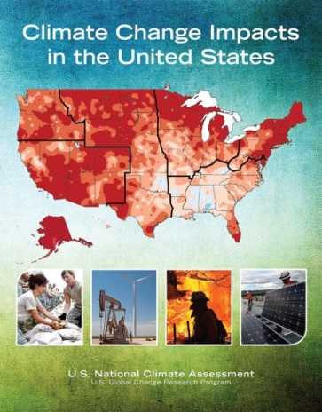
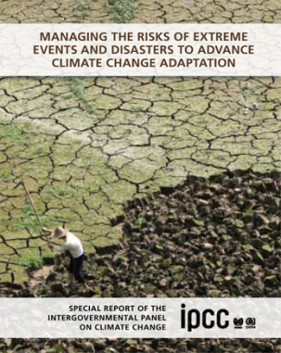
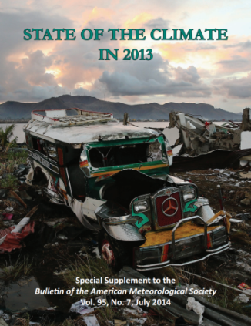
Assess the Earth’s Climate: International, National, Annual Assessments
International
Assessments
3 NCDC lead authors and review editors on Fourth Assessment Report
2 NCDC lead authors on Fifth Assessment Report
Annual
Assessments
NCDC coordinates 378 authors from 48 countries
Covered by all major news networks, briefed to Hill staff
National
Assessments
NCDC provides leadership for all National Climate Assessments
NCDC hosts National Assessment’s Technical Support Unit
Notes:
International
Assessments
3 NCDC lead authors and review editors on Fourth Assessment Report
2 NCDC lead authors on Fifth Assessment Report
2 NCDC lead authors on Special Report on Extremes
National
Assessments
NCDC provides leadership for all National Climate Assessments
NCDC hosts National Assessment’s Technical Support Unit
Annual
Assessments
NCDC coordinates 378 authors from 48 countries
Covered by all major news networks, briefed to Hill staff

Slide 19
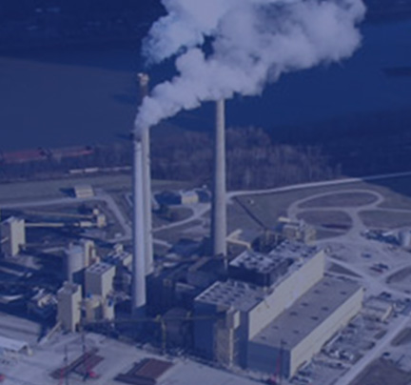
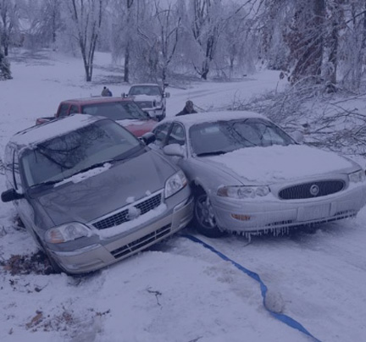
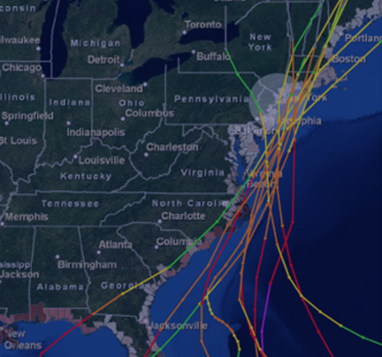
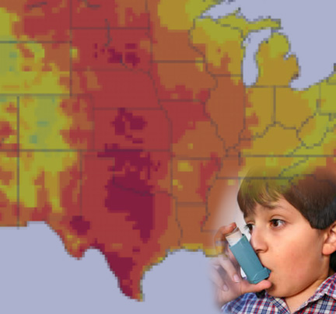
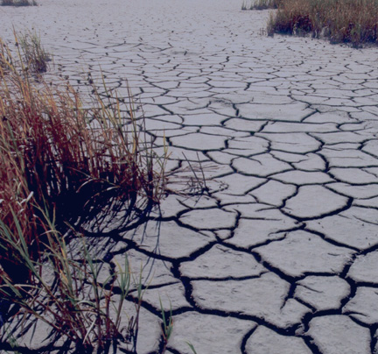
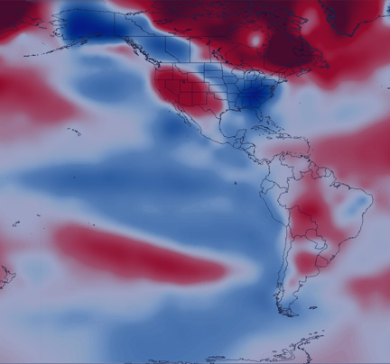
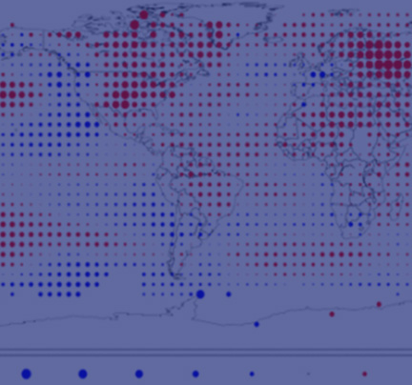
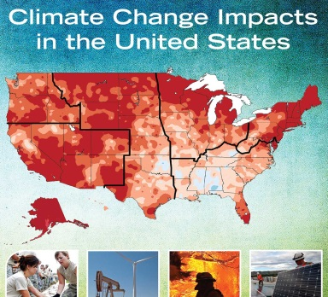
Climate Products and Services
Weekly
Monthly
Seasonal – Annual
Decadal
Snowfall Impact Index – FEMA, disaster response
Billion $ Disasters, Climate Extremes Index
–
Insurance
Heating & Cooling Degree Days – Energy Sector
Temperature & Precipitation Outlooks – Agriculture
Local
Hurricane Tracks – Emergency Planners
Heat Wave Prediction
–
Public Health Officials
Climate
Normals
–
Construction, Infrastructure, Agriculture
Drought Outlook
– Agriculture
Regional
Drought Monitor
– Agriculture
Monthly State of the Climate Reports – Decision Makers
Annual State of the Climate Reports – Decision Makers
National Climate Assessment
–
Decision Makers
National
& Global

Slide 20
Outline
A Climate Data Record Program for NPP/NPOESS
The diverse and growing climate application community, its changing needs and expectations
Meeting climate community product & service needs
Information vs. Data
Ease of access
Latency
Longevity

Slide 21
CDR Program: Refining Role Per Changing Needs
“The Secretary of Commerce, through the NOAA Administrator, will also process long time-series data from these [satellite observations for monitoring and predicting weather] for reanalysis and modeling to better understand seasonal to decadal climate trends.”
Civil Plan for Earth Observations, OSTP, July 2014
NOAA is a science-based services agency
“Use-inspired”: Products and services are developed in response to user needs
Research-driven development is primarily elsewhere
Example: Climate Information Responding to User Needs (CIRUN) Roundtable
“Can we get consistent data series on average and extreme events (e.g., that disrupt business operations) so that current trends in climate can be established? [Want] to inter-compare locations (state, city) and changes … through time.”

Slide 22
Outline
A Climate Data Record Program for NPP/NPOESS
The diverse and growing climate application community, its changing needs and expectations
Meeting climate community product & service needs
Information vs. Data
Ease of access
Latency
Longevity

Slide 23
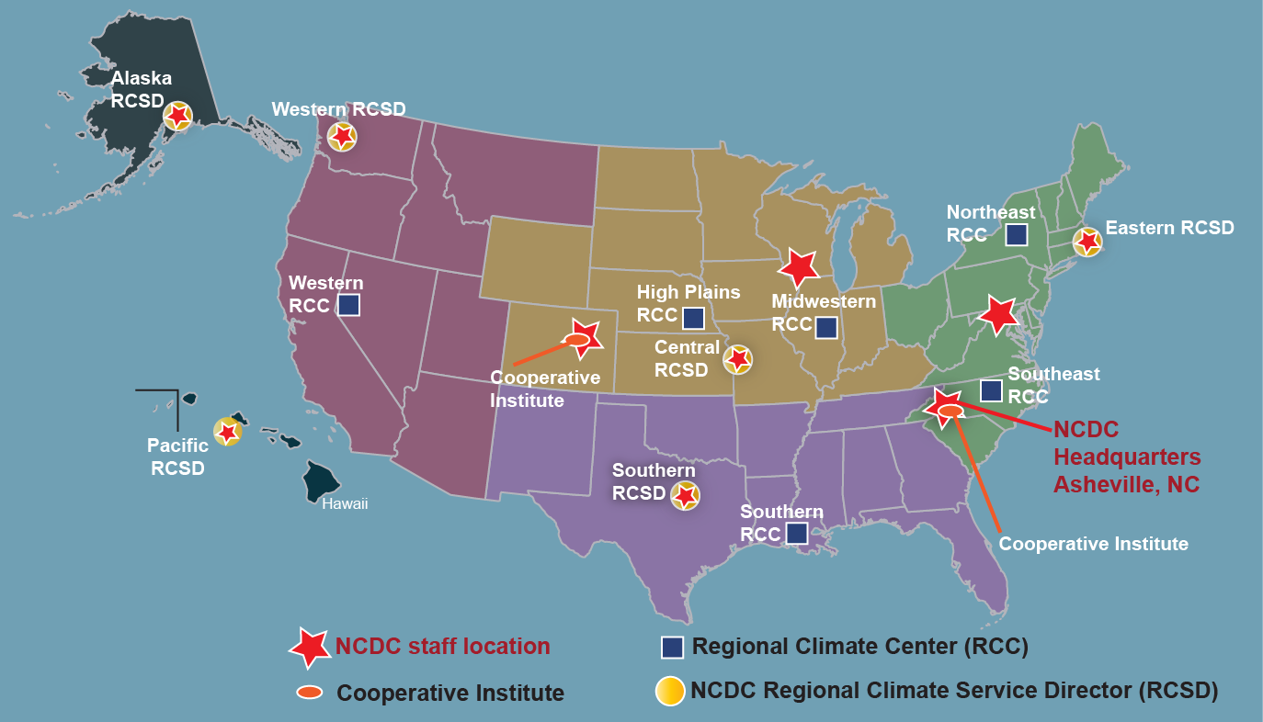
Use-Inspired Products → User Engagement

Slide 24
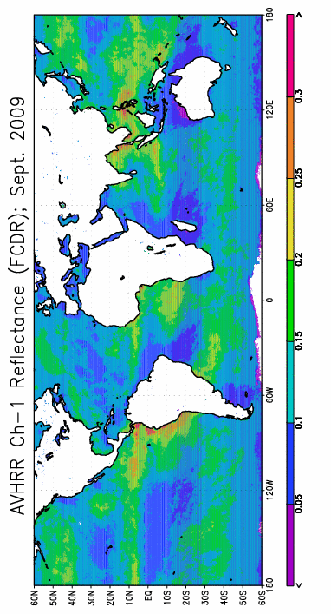
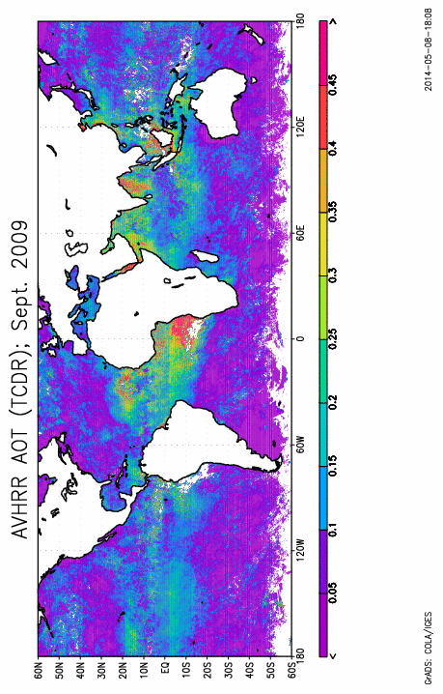
From Records…
Homogenized AVHRR Reflectance
Homogenized Aerosol Thickness

Slide 25
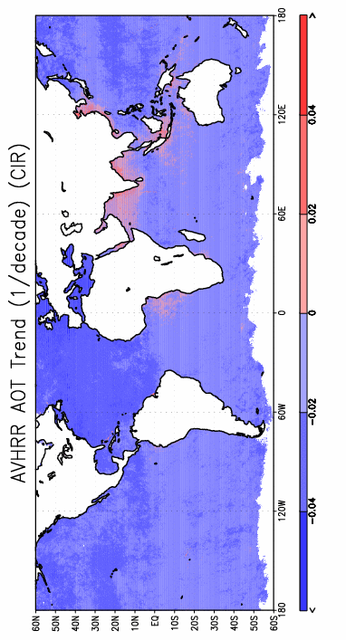
From Records to Information
Homogenized AVHRR Reflectance
Homogenized Aerosol Thickness
Aerosol Trends

Slide 26
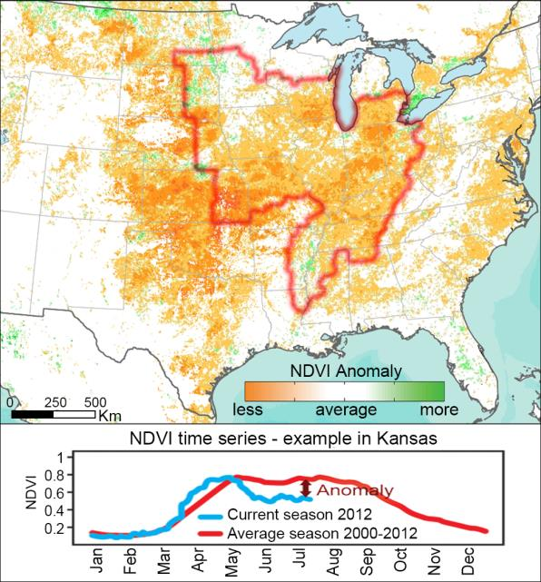
2012 drought depicted by Vegetation Index CDR (July 17)
CDRs Supporting Farming and Agribusiness
Example: historical context
5 km resolution, “wall-to-wall” (globally)
Historical record from 1981- to current
Collateral products
Surface Reflectance
Leaf Area Index (LAI)
FPAR (photosynthetically active radiation)
Primary U.S. corn and soybean region

Slide 27
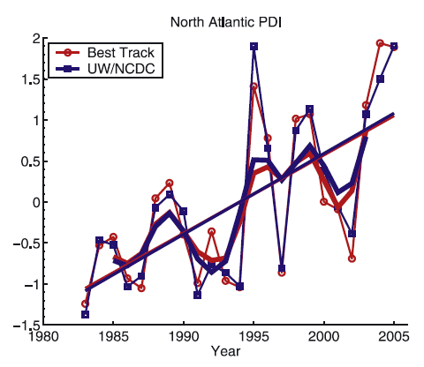
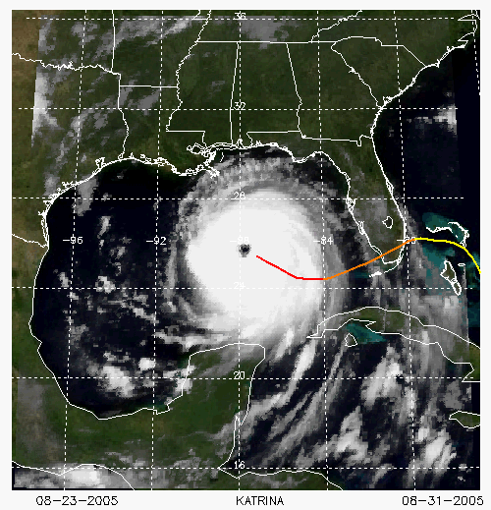
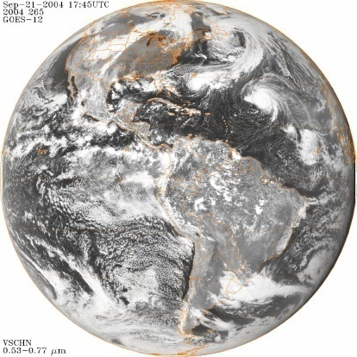
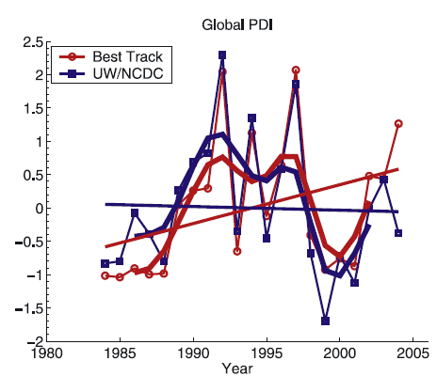
Records-to-Information: Hurricane Trends
Generate Homogeneous Records
Identify Anomalies
Trend the Anomalies
29 Geostationary Satellites + 8 Polar Satellites
30 Years
Hurricane intensity trends
(Kossin et al. 2007)

Slide 28
Outline
A Climate Data Record Program for NPP/NPOESS
The diverse and growing climate application community, its changing needs and expectations
Meeting climate community product & service needs
Information vs. Data
Ease of access
Latency
Longevity

Slide 29
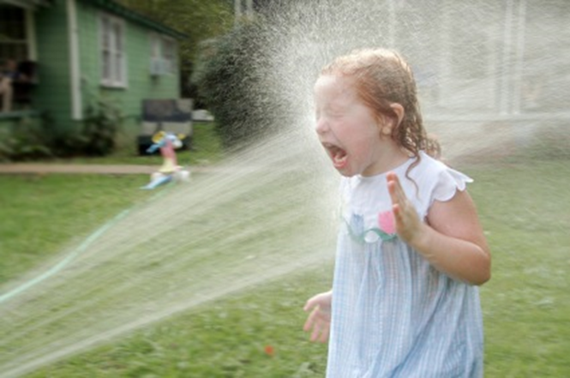
Provide Climate Data Access to (Much Larger) Point-N-Click User Community
Provider Model of Data Access
User Model Of Data Access
Going from “drinking from the fire hose” to “sipping a cup of tea”
Web Services
Notes:
In an age where satellites, radars, and climate models produce terabytes of data each day, and where dozens of research groups produce and maintain hundreds of similar climate data sets, the shear volume of data can inhibit effective access and analysis. Our ultimate goal is to reduce the effort required to access the right information, regulate the quantity of the data so only the desired amount is delivered, ensure the quality by establishing certain state-of-the-science reference data sets, and let the end user integrate the climate data with their data to produce relevant assessments, comparisons, or analyses.
To this end, we have been developing the Integrated Marine Protected Area Climate Tools (IMPACT) add on to the NOAA Weather and Climate Toolkit. This tool is part of the NOAA-wide IMPACT framework that we have been leading development of at NCDC for the past several years. The WCT-IMPACT is one of several tools intended to reside within the IMPACT framework. We should also note that the WCT-IMPACT tool has been developed for NOAA as part of the CDR project. This is a Federal tool, and so we are not designing this to compete with more advanced commercial software, but rather to complement them by making it easier for users to obtain relevant data for further analysis.

Slide 30
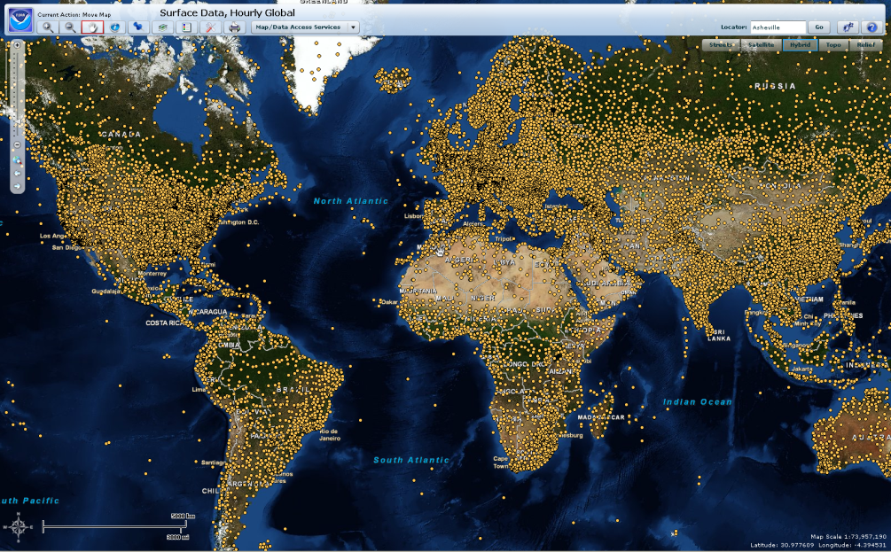
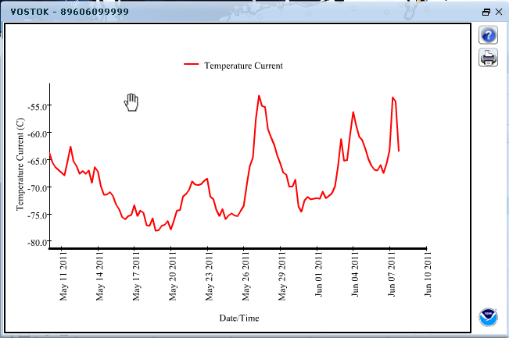
Example: Map/Web Services & Data Visualization
GIS Map Services allow easier data visualization, selection and use
Web Services such as WMS, WFS, KML/KMZ (for Google Earth, etc.)
Data visualization via tools such as Multigraph provide graphical display of various parameters

Slide 31
Outline
A Climate Data Record Program for NPP/NPOESS
The diverse and growing climate application community, its changing needs and expectations
Meeting climate community product & service needs
Information vs. Data
Ease of access
Latency
Longevity

Slide 32
Traditional Satellite Processing Scenarios Limit Applications
Research Support (Epoch reprocessing of complete period of record, Complete, State-of-the-art)
Quality (accuracy, completeness, etc.)
Operational Weather (Quick, Robust, Data as-available, Algorithm as-is, Sensor-unique)
Minutes
Days Weeks
Years
Decades
Time past observation (logarithmic scale)

Slide 33
Expanding Decision Support Applications
Research Support (Epoch reprocessing of complete period of record, Complete, State-of-the-art)
Quality (accuracy, completeness, etc.)
Decision Support
(Routine, Complete, Timely, Climate processing, Consistent in time/space/resolution over period-of-record)
Operational Weather (Quick, Robust, Data as-available, Algorithm as-is, Sensor-unique)
Minutes
Days Weeks
Years
Decades
Time past observation (logarithmic scale)

Slide 34
Expanding Decision Support Applications
Research Support (Epoch reprocessing of complete period of record, Complete, State-of-the-art)
Quality (accuracy, completeness, etc.)
Decision Support
(Routine, Complete, Timely, Climate processing, Consistent in time/space/resolution over period-of-record)
Operational Weather (Quick, Robust, Data as-available, Algorithm as-is, Sensor-unique)
Minutes
Days Weeks
Years
Decades
Time past observation (logarithmic scale)

Slide 35
Interim Climate Data Records (ICDRs) Can Reduce Latency With Little Impact on Quality
Precipitation Amounts and Anomalies from the Global Precipitation Climatology Project
Interim Climate Data Record (3-4 days behind real time)
Climate Data Record (2-3 months behind real time)

Slide 36
Outline
A Climate Data Record Program for NPP/NPOESS
The diverse and growing climate application community, its changing needs and expectations
Meeting climate community product & service needs
Information vs. Data
Ease of access
Latency
Longevity

Slide 37
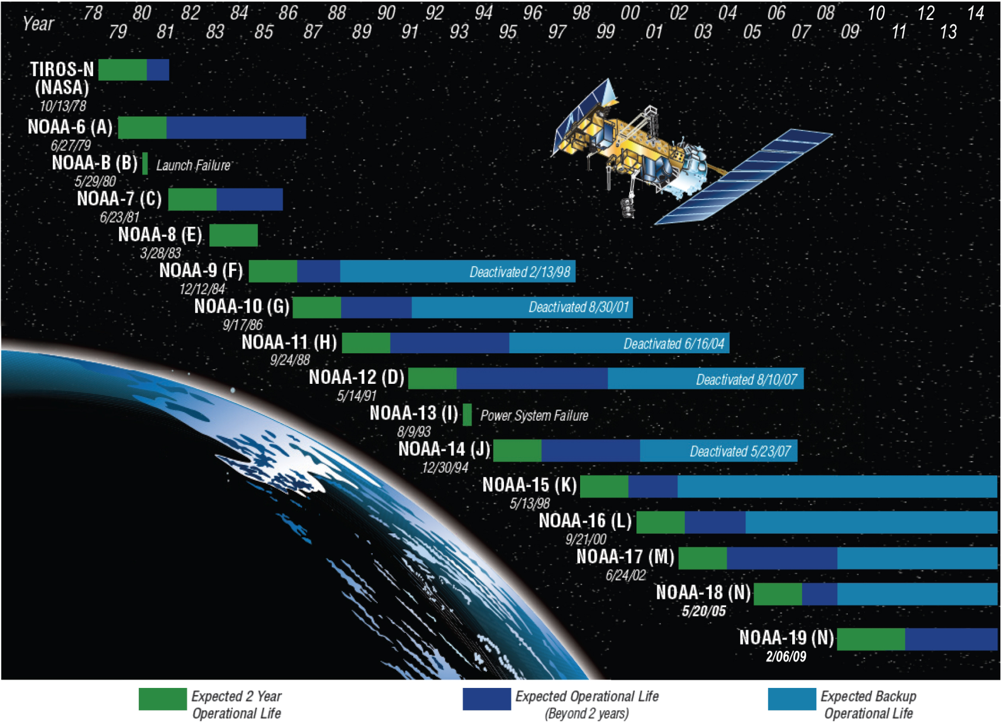
,
S-NPP
Notes:
Polar-orbiting Operational Environmental Satellite (POES) and Defense Meteorological Satellite Program (DMSP)
First launched in 1978
870 km (541 miles) above the Earth

Slide 38
“Climate” Barely Measureable by Satellites

Slide 39
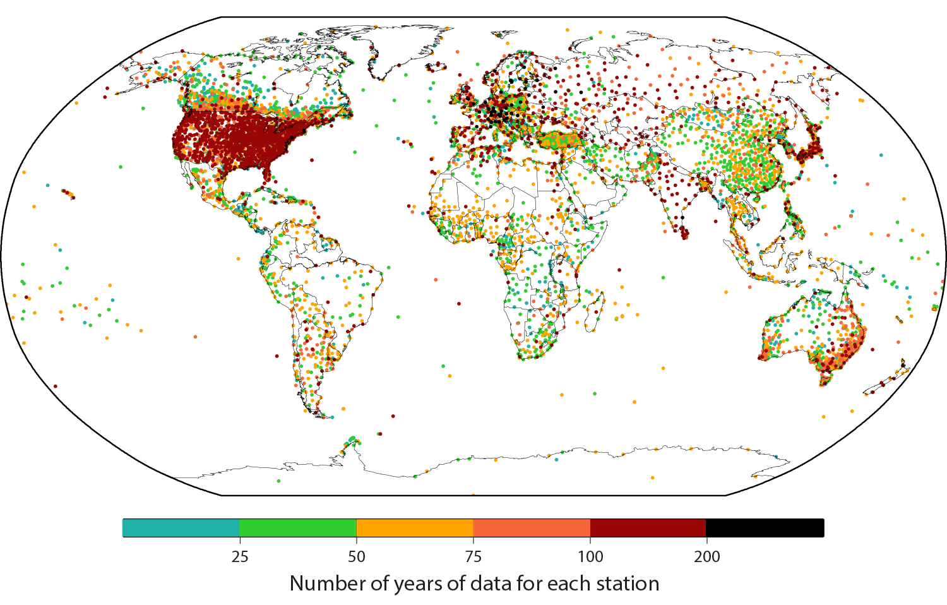
Land Surface Temperature Record Extends Centuries
NCDC monitors changes in global land surface temperature using the Global Historical Climatology Network-Monthly (GHCN-M) dataset
This dataset provides monthly average temperatures from 7,280 stations, some of which contain records back more than 300 years
Notes:
First developed in the 1990s, version 3 was released in May 2011
A new version is expected to be released during early FY13 with a more than three-fold increase in the number of stations.

Slide 40
In Situ Sea Surface Temperature (SST) Tells a Story Not Observable by Satellites
Notes:
2011 Global Ocean Temperature Anomaly was 0.40 deg C / 0.72 deg F and tied with 2007 as the 11th warmest year since records began in 1880
The warmest year on record is 2003 with an anomaly of 0.52 deg C / 0.94 deg F

Slide 41
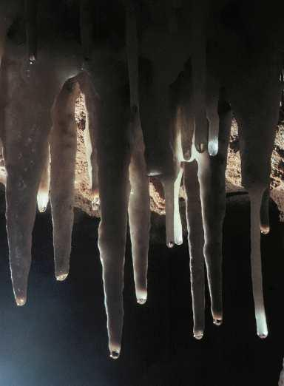
There’s More! Paleoclimatologic Data
McCabe-Glynn et al. 2013 Nature Geoscience
Crystal Cave, CA
d¹⁸O also reconstructs causes of past hydrologic variations, which can improve monitoring and forecasting
Notes:
mccabe

Slide 42
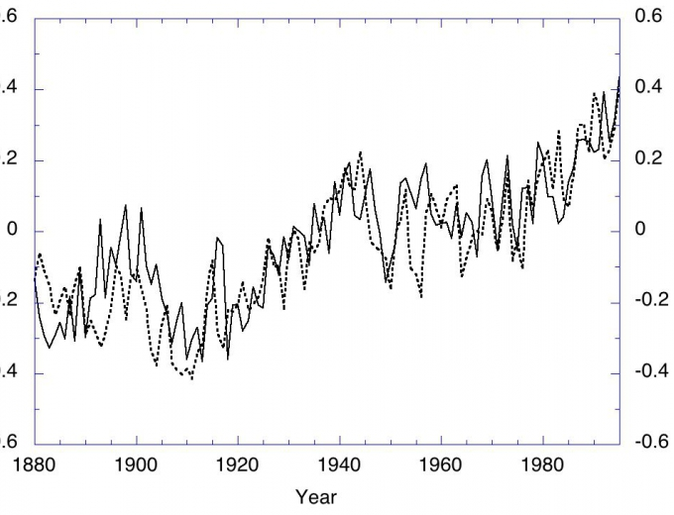
Paleo Proxy Data Is Consistent With Instrumental Record
Paleo Index (solid line)
Temperature°C
Thermometer record (dashed line)
Standardized Units
Anderson, et al., 2013, Geophysical Research Letters
Global average temperature time series constructed by averaging data from 173 different published studies that use proxy data known to be temperature sensitive.

Slide 43
Summary
NOAA’s evolving Climate Data Record Program provides lessons for serving climate applications community
Community many science experts, but many more non-experts
Non-experts in business, and decision makers, and the public increasingly expect:
Highly derived, transformed and/or translated climate information rather than homogenized observations
Point-and-click access to that information
Minimal lags from real time
Historical context of today’s events via centuries-long record
NOAA’s CDR Program is actively addressing these focus areas
Traditional CDRs will be sustained as user demand warrants

Slide 44
NOAA’s
National Climatic Data Center
www.ncdc.noaa.gov
www.climate.gov
www.twitter.com/NOAANCDC
www.facebook.com/NOAANationalClimaticDataCenter

Slide 45
NOAA CDRP Evolution – 3 Phases
CDRP began in 2009 at National Climatic Data Center (NCDC) of NOAA/NESDIS
Selections based on best science, most mature algorithms
Targeted satellite CDRs per Congressional language and NESDIS guidance
Focused on Essential Climate Variables (ECVs), with initial priority on FCDRs from legacy operational sensors and critical TCDRs identified by the IPCC and others
Competitive grants were awarded to capture leading knowledge from the research community
CDRP pivoted in 2012 towards “Use-Inspired” CDRs per NOAA/NCDC guidance
Sections based on best use, widest applications for societal benefits
Focused on engagement with industry and public to identify their needs and prioritize the CDRs capable of meeting those needs
Refined processes, policies, and procedures for R2O and information preservation
Products are under project, configuration and risk management (~ CMMI Level 2)
Grant work switched to Contracts as CDRs transitioned to operations, to reduce operational risk
CDRP now (2014+) transferring operational capabilities to the wider community
CDR Best Practices are adaptable and scalable, and extend beyond NCDC
Build ties to user services, science, monitoring, software engineering, and overall processes such as configuration management (CM) and quality management (QM)
Incorporating in-situ and blended products into CDR Program to secure those products for the future as well as the satellite CDRs
Matrix-oriented, to enable efficiencies and sustainability within NCDC and NOAA/NESDIS
Notes:
2. Water and Energy Cycle-related CDRs were given priority.
R2O: “Research to Operations” transition.

